Slide 1
ITSC 200 – Network Protocols and Security
Wireshark

Slide 2
Today’s Objectives
To learn to use Wireshark to observer network traffic

Slide 3
What is Wireshark?
Wireshark is a free software-based packet capture program that allows network professionals to exam network traffic at a detailed level.
These .pcapng files allow us to review network traffic for a specified time period at our leisure.

Slide 4
What is Wireshark?
Wireshark is a “network sniffer”
Many uses as a network administrator:
Tracking down networking bottlenecks
Identifying suspect content in network traffic
“Understading” how a protocol works
Gathering statistics

Slide 5
Downloading Wireshark
Windows:
https://2.na.dl.wireshark.org/win64/Wireshark-win64-3.4.3.exe
Mint/Ubuntu/Debian:
sudo apt install wireshark wireshark-qt

Slide 6
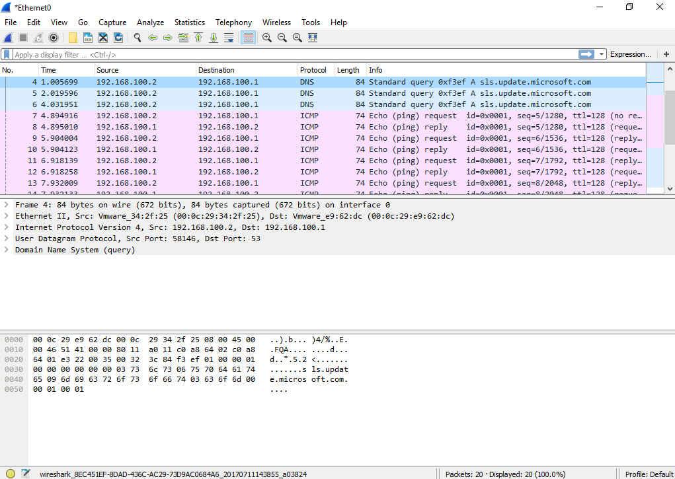
Wireshark

Slide 7
Wireshark
Wireshark refers to “packets” but would be more accurate if it called the lines “frames”.
When we talk using the OSI model, we need to be precise in our use of terms.
Transport layer PDU’s are called “segments”
Network layer PDU’s are called “packets”
Datalink layer PDU’s are called “frames”
The mnemonic “SPF” (as in sunscreen) is an easy way to remember the difference.

Slide 8
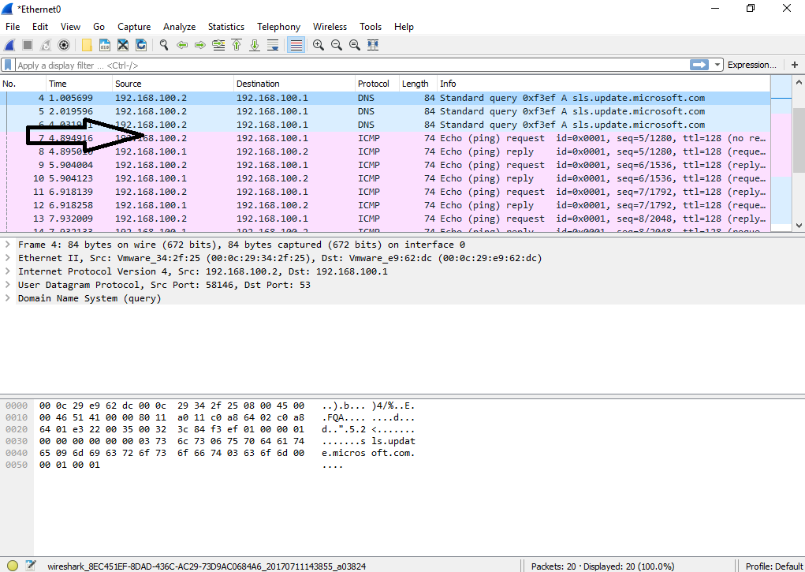
Wireshark
Wireshark has three windows when you start it.
The top window (with the arrow) shows the captured frames.
One frame per line.
Different protocols are different colors.

Slide 9
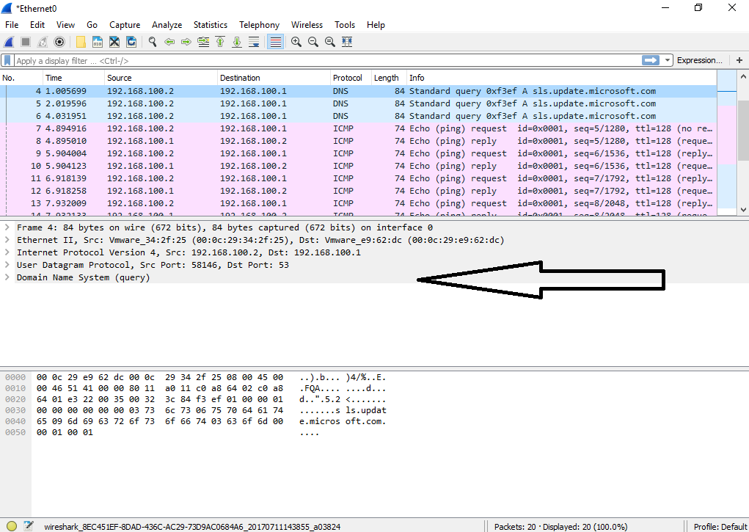
The middle window (with the arrow) shows the details of the highlighted frame in the top window (frame #4).
The “>” beside each line indicates that it can be “expanded” to show more detail.
The lines roughly follow the OSI layers with layer 1 at the top.
Wireshark

Slide 10
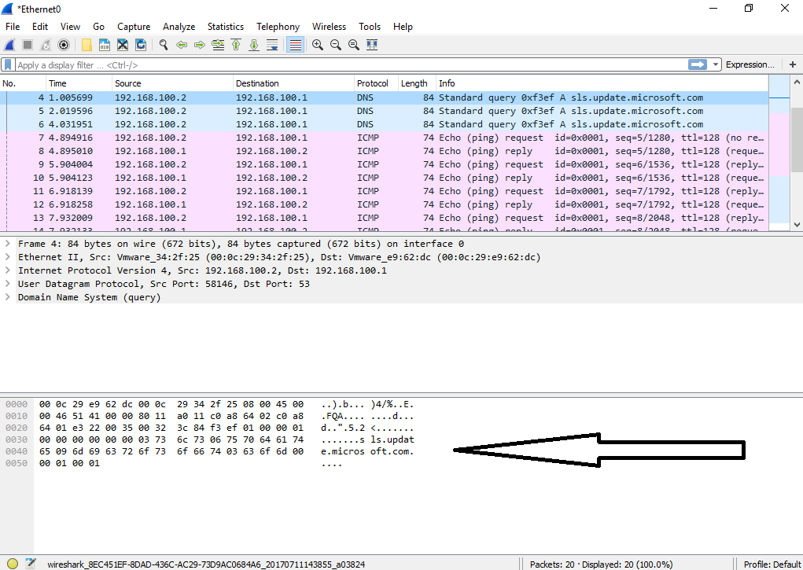
The bottom window (with the arrow) shows the raw data of the highlighted frame in the top window (frame #4).
The data is displayed in hexadecimal and ASCII
Highlighting any of the hex will highlight the ASCII that it represents.
Wireshark

Slide 11
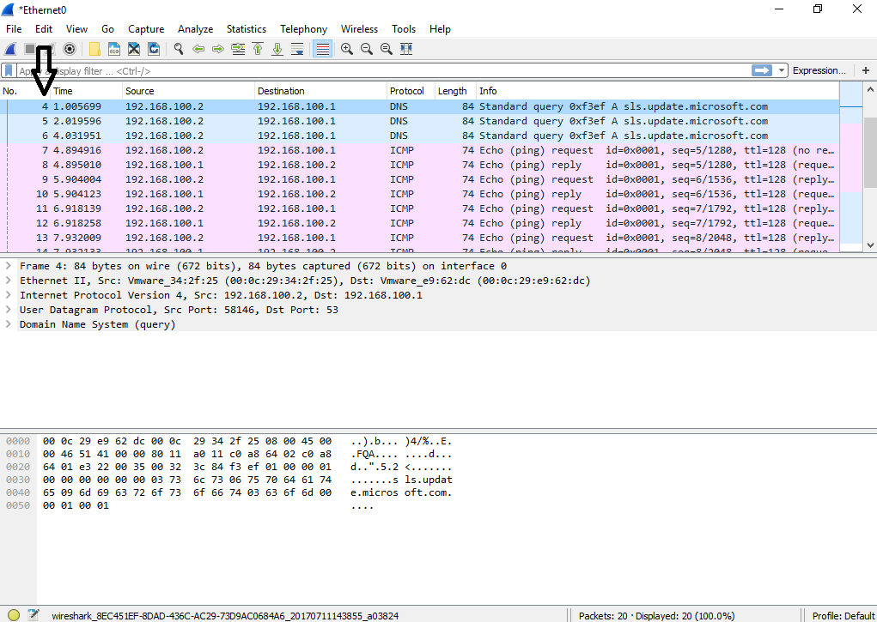
Wireshark
The left column (with the arrow) shows the number of the frame capture … so the highlighted frame is the 4th frame captured.
Occasionally, these may not be in the order that you expected simply because of network delays or processing delays.

Slide 12
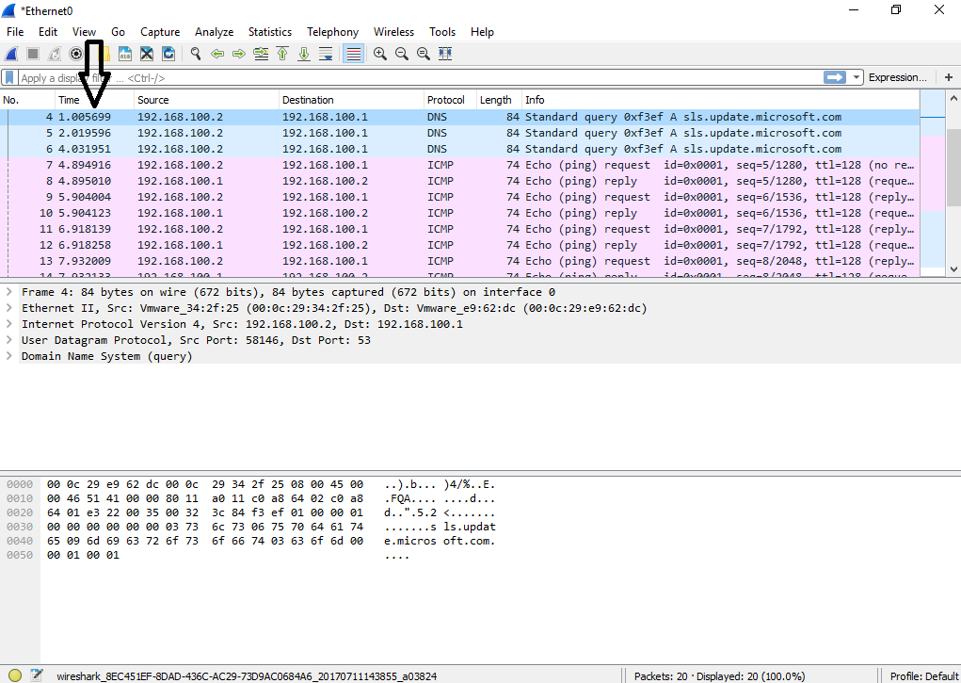
Wireshark
The next column (with the arrow) shows the time delta of the frame capture … so the 5th frame was caught .005699 seconds after the capture was started.
This is important as there can be bursts of traffic.

Slide 13
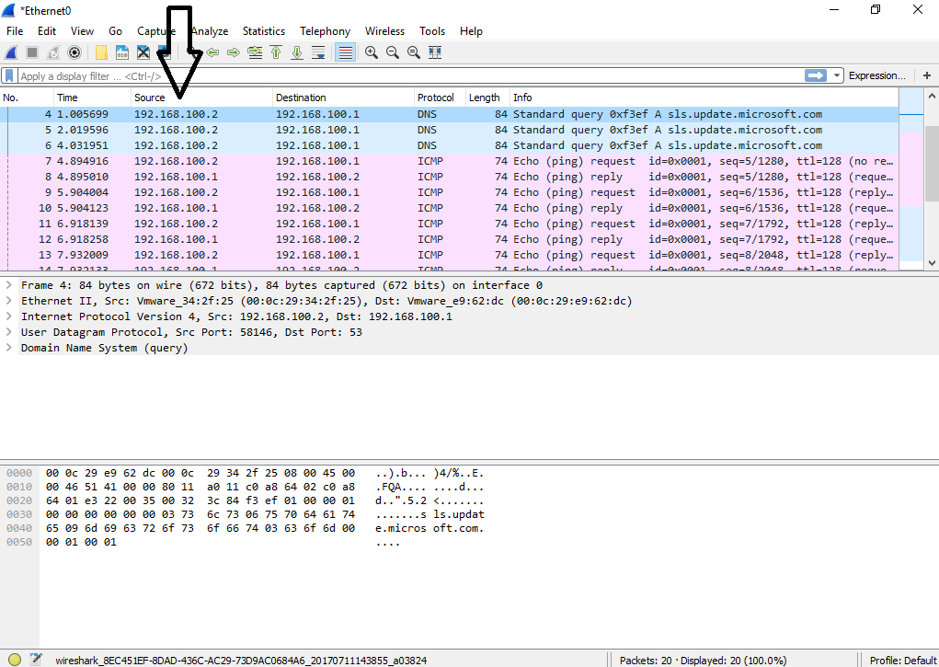
Wireshark
The next column (with the arrow) shows the source IP address of host that sent this frame.
For reasons that we will discuss, this can’t always be trusted.

Slide 14
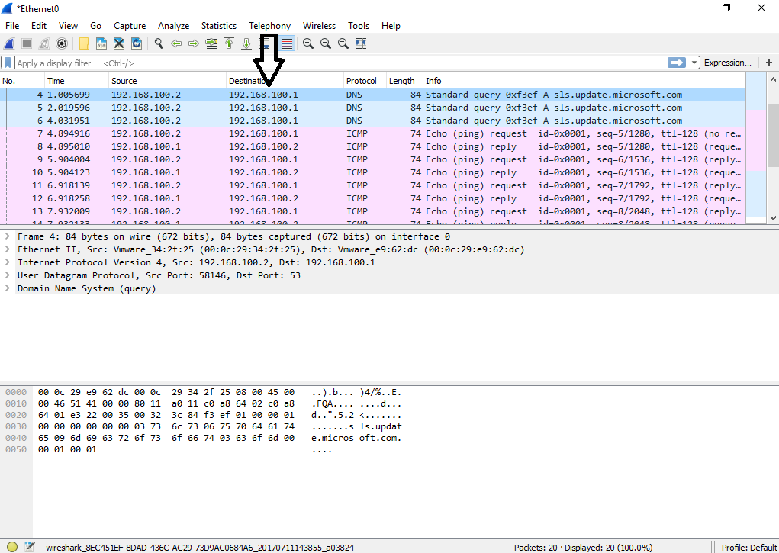
Wireshark
The next column (with the arrow) shows the destination IP address (the computer receiving the frame).

Slide 15
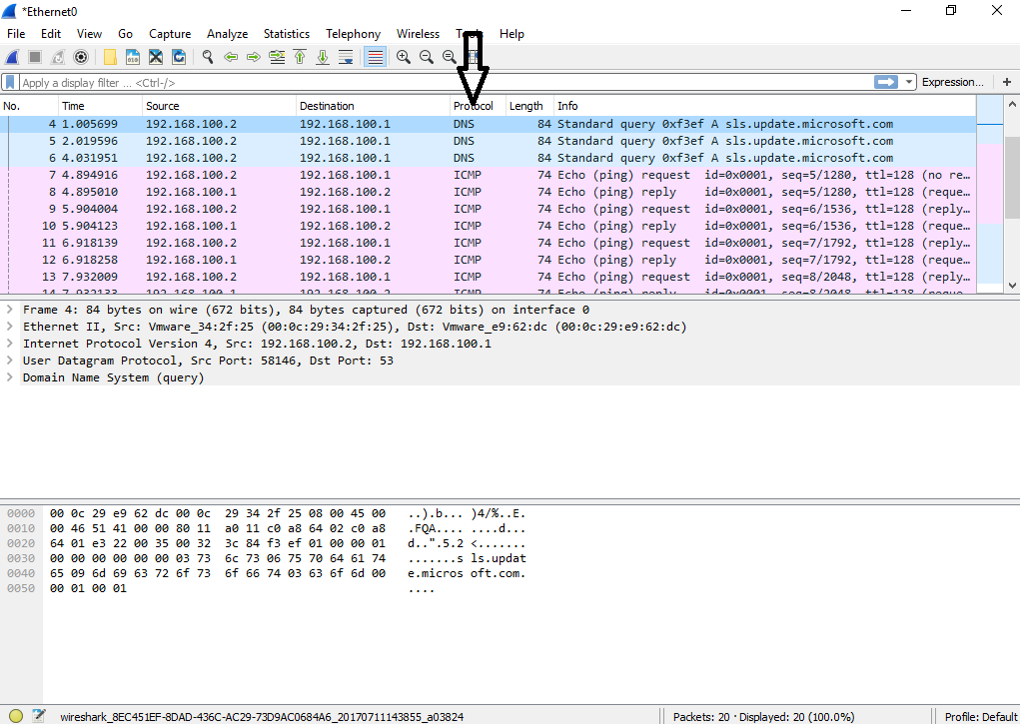
The next column (with the arrow) shows the higher level protocol that the frame is carrying. Here, you can see it in the last line of the middle window as well.
Wireshark

Slide 16
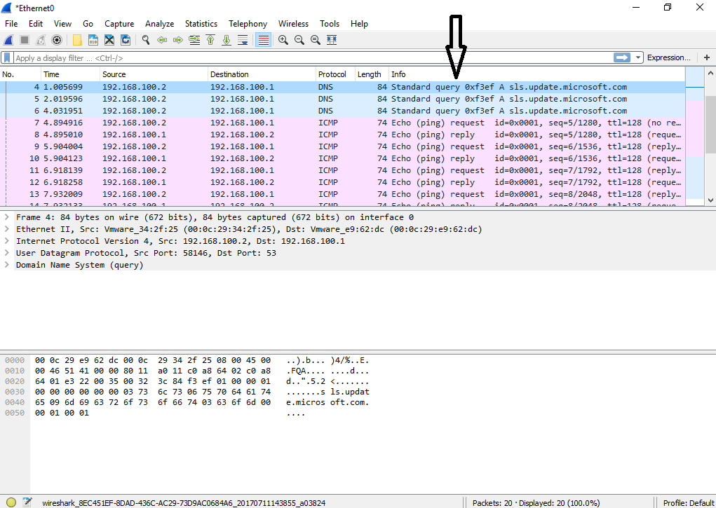
The next column (with the arrow) gives more information about the frame. You can see that frame 9 is an ICMP Echo (or Ping) request.
Wireshark

Slide 17
Wireshark
It is important to determine where we should do our capture on the network. Generally, we want the capture to be as close as possible to the problem.
The use of layer 2 switches on networks (the norm) means we cannot (easily) capture all the traffic.

Slide 18
Wireshark
Layer 2 switches create a special problem for us when capturing.
Because a layer 2 switch will isolate unicasts to only those PC’s in the conversation, we can’t see unicasts between other parties.

Slide 19









Wireshark
Layer 2 Switch
Network

Slide 20
ARP on a Switched Network
ARP with no Reply
ARP with Reply

Slide 21
Wireshark
Network

Slide 22

Wireshark
Network
But we won’t be able to capture traffic that stays in the Switch!

Slide 23
Wireshark
One solution would be to use “port mirroring”
The switch will send a copy of network packets it sees to one specific port on the switch.
You can then use this specific port for monitoring.
Switched Port Analyzer (SPAN) on Cisco devices
Roving Analysis Port (RAP) on 3Com

Slide 24
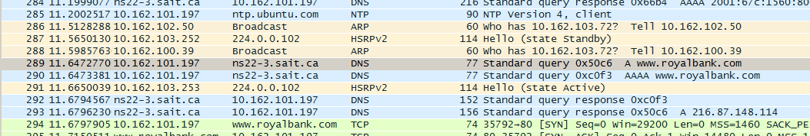
How does Wireshark use the OSI model ?
Download http_osi_royalbank.pcapng and open it with Wireshark.
Go to frame 289 and determine the IP addresses we will be dealing with. I have enabled name resolution in Wireshark preferences so you can see the server name here.

Slide 25
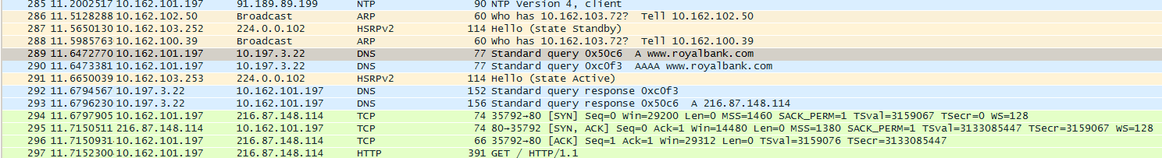
How does Wireshark use the OSI model ?
This is the same capture but with IP name resolution turned off.

Slide 26
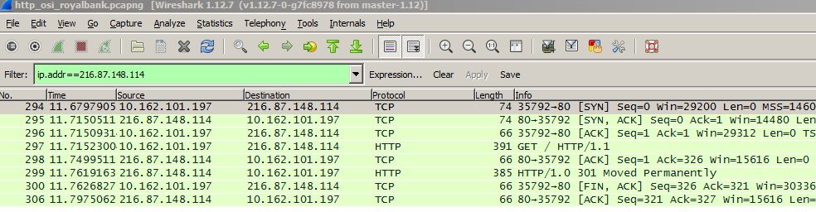
How does Wireshark use the OSI model ?
We can use a filter here to help us.
Use “ip.host==hostname” as well (IP name resolution must be enabled in Wireshark preferences)

Slide 27
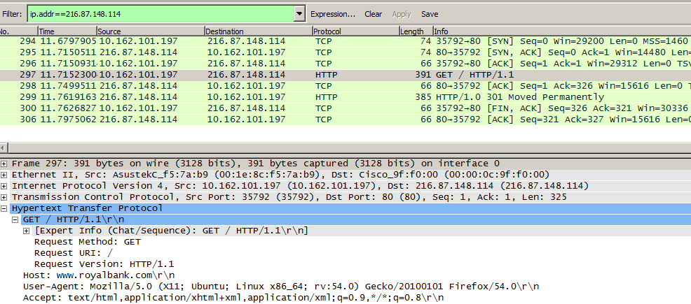
How does Wireshark use the OSI model ?

Slide 28
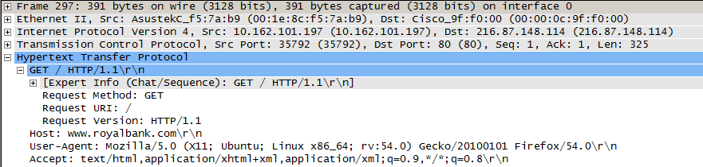
How does Wireshark use the OSI model ?
1
2
3
4

Slide 29
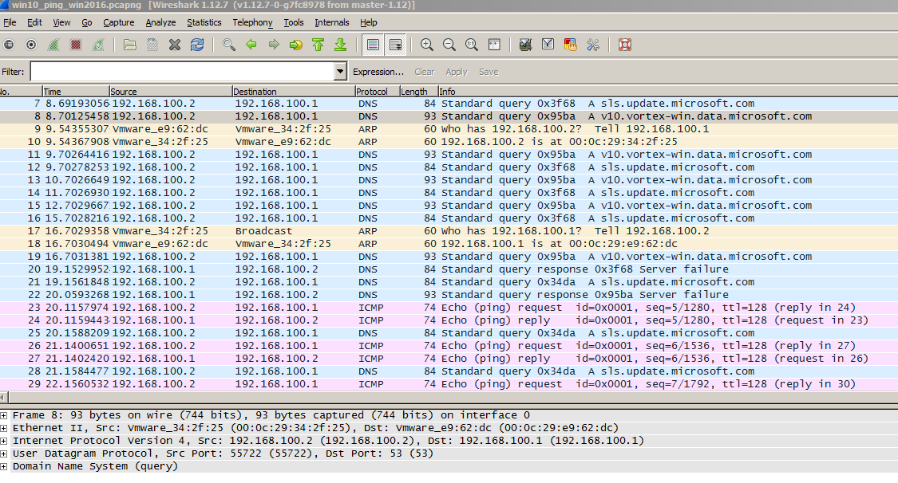
Here is a Windows 10 computer pinging its Windows Server 2016 domain controller.
We are going to take a close look at this actual capture.
Wireshark

Slide 30
Download the file win10_ping_win2016.pcapng
Load it into Wireshark on your laptop.
Wireshark

Slide 31
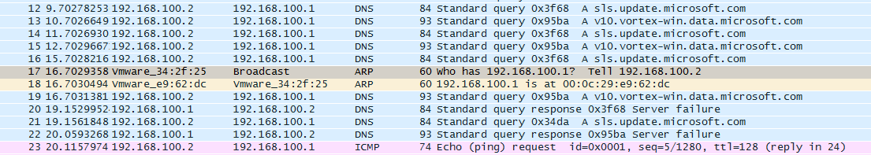
Wireshark
Look at frame 17
This is the ARP request before the ping.
Anything unusual about it ?
Note the reply directly under it.

Slide 32
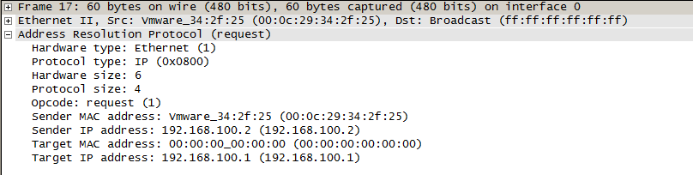
Wireshark
This is the detail of frame 17. There are some things we should note here :
The target MAC address is all zero’s.
It is a hardware broadcast (ff:ff:ff:ff:ff:ff:ff:ff)
What does “Hardware size: 6” mean ?
What does “Protocol size: 4” mean ?

Slide 33
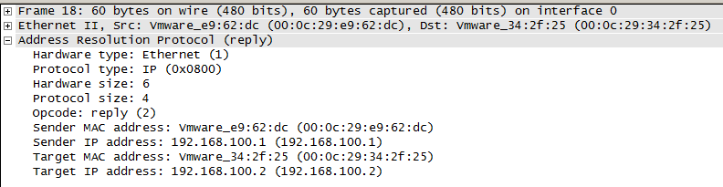
Wireshark
Highlight frame 18, the reply to frame 17.
It looks very similar to frame 17, but what are some key differences ?

Slide 34

Wireshark
Highlight frame 23, the Echo (Ping) request.
Look at the size “on the wire”. Is this a large or small Ethernet frame ?
What is unusual about its payload (raw data) ?

Slide 35
Wireshark
Go to “Statistics” and “Capture File Properties”.
We can get some interesting information from this summary.
For instance, I can see the average packet size (79.5 bytes)
I can see the average byts/sec (113). This is not a large enough sample (only 33 packets) to give us a reliable measurement here.

Slide 36
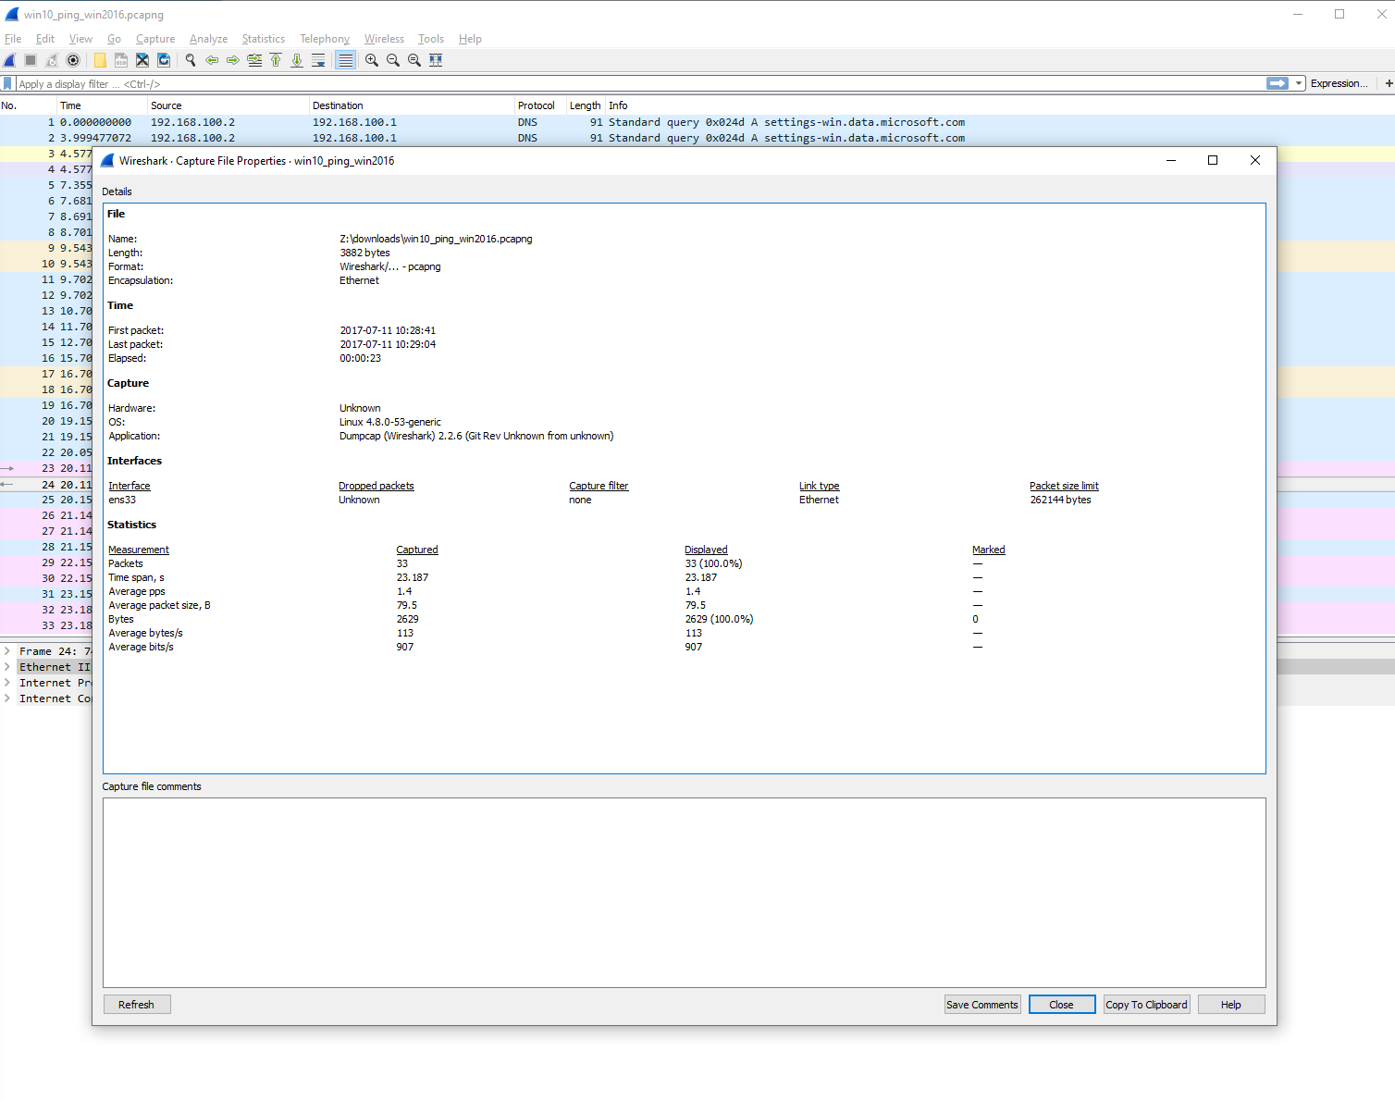
Wireshark

Slide 37

Coffee Break!

Slide 38
Wireshark – adding filters
Download dhcp.pcapng
Use filters (upper left) to find specific types of traffic.
Enter the protocol “dhcp”. Notice it turned red.
That is not a recognized filter.
DHCP actually derives from an earlier protocol that is still used, Bootp.
Type bootp into the filter area. Notice that it turned green.
This doesn’t mean that there is DHCP/Bootp traffic, only that the filter is a valid filter.

Slide 39
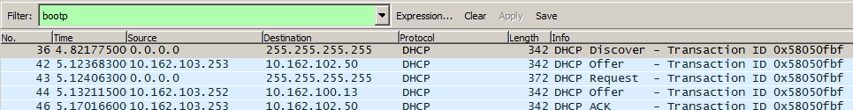
Wireshark – adding filters
So go ahead and apply the bootp filter and your Wireshark should look like the graphic below
Why are there 5 packets and not 4 ? (Use the mnemonic Dora (the explorer) to remember the DHCP sequence)
Note that after using the filter you must “clear” it to see all of the traffic again.

Slide 40
Analyzing a zombie
A computer in my network has been compromised.
I suspect it is being used to conduct distributed denial-of-service attacks!
Luckily, I was able to capture some of the traffic from when this began.
Download botnet.pcapng

Slide 41
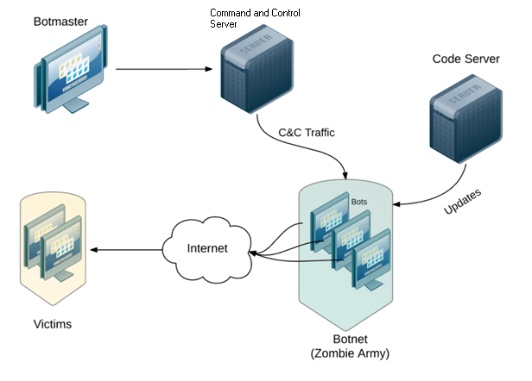
Structure of a Botnet

Slide 42
Analyzing a zombie
botnet.pcapng is a big file!
~36 MB
All network traffic from a single machine on my network for about 120 seconds.
Things I want to know:
What machine is this?
Where is the Command and Control server?
Where is the Code server?
What targets did it attack?

Slide 43
Analyzing a zombie
First look
There’s a lot of (encrypted http) traffic
add the filter ssl
You will see that protocol is shown as TLS
We will talk about this in a few weeks.

Slide 44
Analyzing a zombie
First look
Not a lot of (unencrypted) http requests
add the filter http
You will see some OSCP entries, but these are not interesting at the moment.
You can remove them by using “and not ocsp”
See anything odd? Take a note of that frame #

Slide 45

Analyzing a zombie
Maybe that is the Code Server?

Slide 46
Analyzing a zombie
HTTP and HTTPs didn’t reveal a lot.
Too many requests
Analyzing Protocol Hierarchy might give us a better view of the situation

Slide 47
Analyzing a zombie
Nop. We didn’t learn a lot there.
Maybe we should follow the conversations?
Look under IPv4
Sort by Packets
It appears our machine is sending a lot of packets to a few hosts.
Not a crime, yet.

Slide 48
Analyzing a zombie
Now look under the TCP tab
Address A is our compromised machine
Address B is the external host
Notice anything similar?
Most requests are going to port 443
443 is the standard port for HTTPS (SSL/TLS)
Some requests are going to port 80
80 is the standard port for HTTP

Slide 49
Analyzing a zombie
Anything odd?
Take a look at the two IP addresses.
You can right-click on top of each one and select “Apply as filter -> Selected”
This will allow you to filter a specific exchange

Slide 50
Analyzing a zombie
Let’s look at the first one.
Not a lot of frames, but it was active since 5 seconds after the capture started, until the end.
The first 3 frames are a TCP Handshake
SYN
SYN/ACK
ACK

Slide 51
Analyzing a zombie
It appears our machine has connected to an external host.
Take a look at the 4th entry in this conversation!
JACKPOT!
Let’s take a look at the Flow Graph for these frames

Slide 52
Analyzing a zombie
There we go!
Now we know who is controlling this machine.
How it got infected (?)
Not really, but we have seen how it downloaded an encrpypted payload.
Some of the targets it attacked.
We could probably see a correlation between the DNS queries and the servers it attacked.

Slide 53
Wireshark Lab
Download :
lab4.docx
Student_assign1_who_am_1.pcapng
Student_assign3.pcapng
Student_assign4.pcapng
Student_assign5.pcapng
Student_assign6.pcapng

Slide 54
The End.

